Slide 1


visualizing the
energy transitions of countries under binding climate constraints
Lancaster University
7th April 2017

Slide 2

visualizing the
energy transitions of countries under binding climate constraints
outline
Notes:
Wealthy countries could afford to do that because of fossil fuels. 2 problems with that. Depletion and global warming.

Slide 3
outline
climate
transitions
energy
wrap-up
country results
global results
visualizing the energy transitions of countries under binding climate constraints

Slide 4
outline
climate
transitions
energy
wrap-up
country results
global results

Slide 5
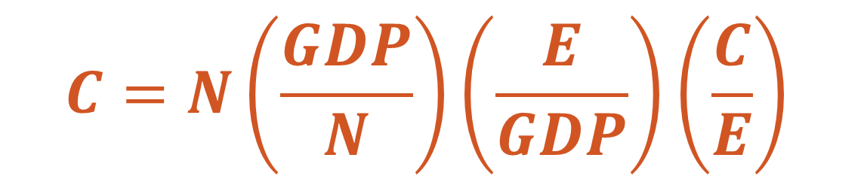
energy
societal emissions modelling through the Kaya Identity (IPAT)
$$C=N\left.\left(\frac{GDP}{N}\right.\right)\left.\left(\frac{E}{GDP}\right.\right)\left.\left(\frac{C}{E}\right.\right)$$
(Chertow, 2000; Commoner, 1976; Ehrlich and Holdren, 1972; Kates, 2000)
Notes:
On top of maximizing GDP as the equivalent of social welfare, IAM’s are also very uncertain

Slide 6
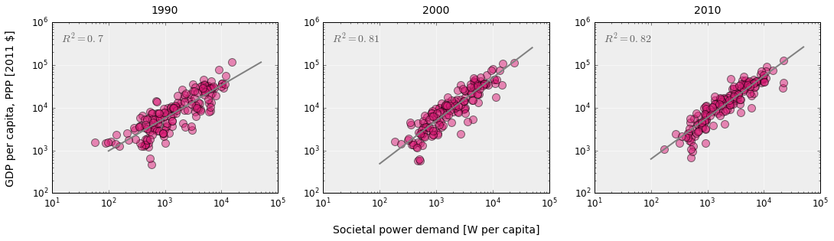
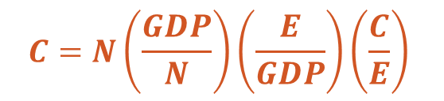
energy
$$C=N\left.\left(\frac{GDP}{N}\right.\right)\left.\left(\frac{E}{GDP}\right.\right)\left.\left(\frac{C}{E}\right.\right)$$
Own work based on open energy and GDP data from World Bank (1990-2010)
Notes:
On top of maximizing GDP as the equivalent of social welfare, IAM’s are also very uncertain

Slide 7
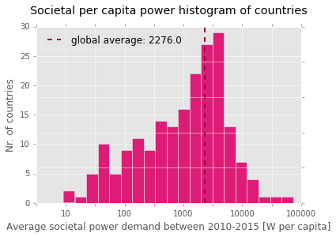
energy
~ 2300 W
Own work based on open energy and GDP data from World Bank (2010-2015)
Notes:
On top of maximizing GDP as the equivalent of social welfare, IAM’s are also very uncertain

Slide 8
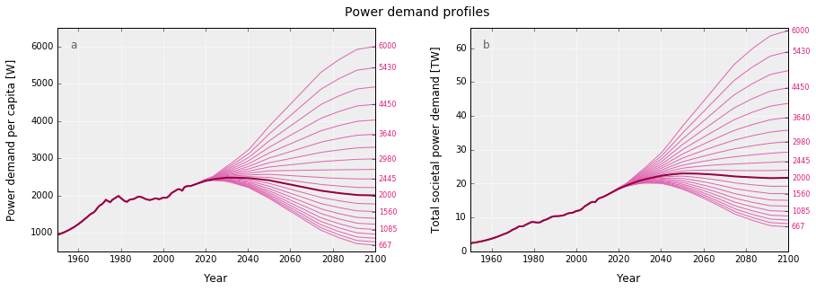
energy
Own work based on Marechal et al. (2005)
Notes:
On top of maximizing GDP as the equivalent of social welfare, IAM’s are also very uncertain

Slide 9
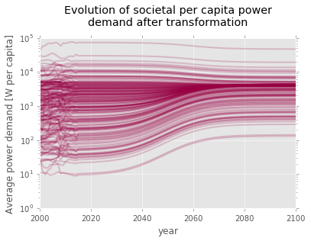
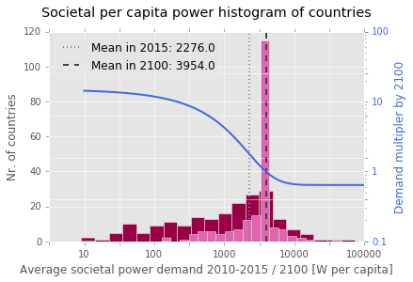
energy
Own work, data source: WDI, years: 2000-2015, own assumptions and calculations for 2100
Notes:
On top of maximizing GDP as the equivalent of social welfare, IAM’s are also very uncertain

Slide 10
visualizing the
energy transitions of countries under binding climate constraints
climate
Notes:
Wealthy countries could afford to do that because of fossil fuels. 2 problems with that. Depletion and global warming.

Slide 11










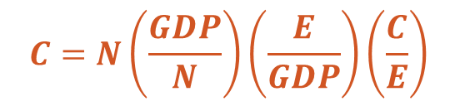
climate
1000
900
<50
gCO₂e/kWh_{e}
600
$$C=N\left.\left(\frac{GDP}{N}\right.\right)\left.\left(\frac{E}{GDP}\right.\right)\left.\left(\frac{C}{E}\right.\right)$$
IPCC AR5 WGII (2014)
Notes:
On top of maximizing GDP as the equivalent of social welfare, IAM’s are also very uncertain

Slide 12
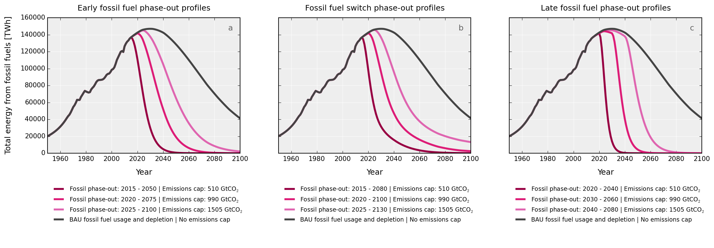
climate
990 GtCO₂
[510 – 1505]
Own work based on open energy data from EIA (1970-2040), BP (1960-2035), population data from UNSD, (1950-2100) , Maggio, Cacciola (2012), Mohr et al. (2015), IPCC AR5 WGI (2014)
Notes:
On top of maximizing GDP as the equivalent of social welfare, IAM’s are also very uncertain

Slide 13
visualizing the
energy transitions of countries under binding climate constraints
transitions
Notes:
Wealthy countries could afford to do that because of fossil fuels. 2 problems with that. Depletion and global warming.

Slide 14
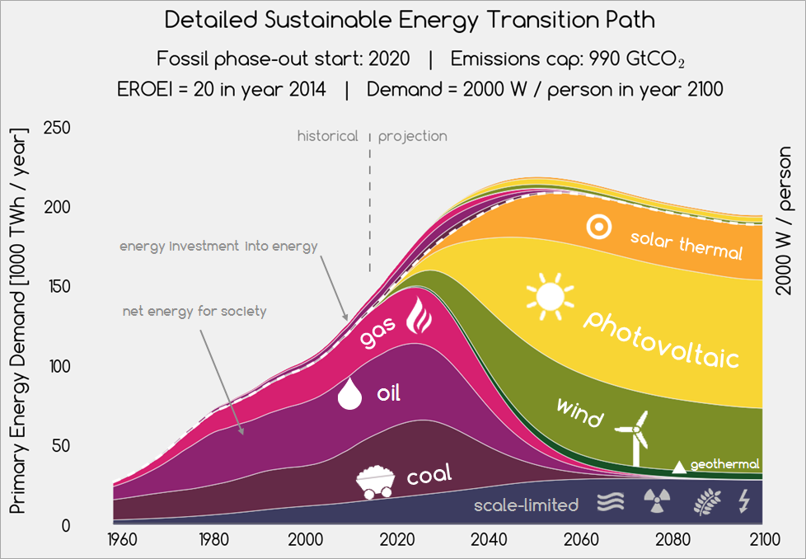
transitions
Own work based on data from, BP, EIA, UNSD, WDI, years 1960-2100, Sgouridis, Csala, Bardi (2016)
Notes:
On top of maximizing GDP as the equivalent of social welfare, IAM’s are also very uncertain

Slide 15
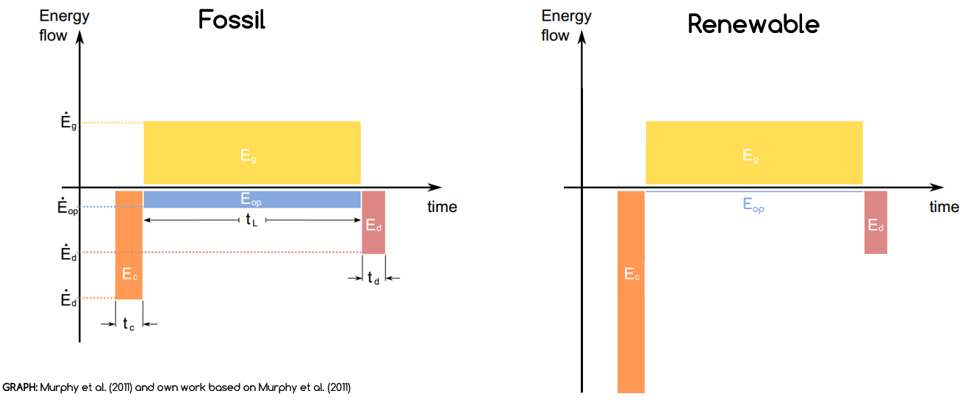
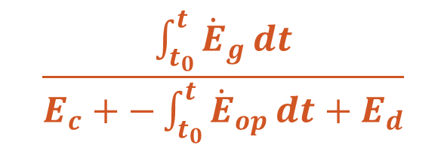
transitions
EROEI
$$\frac{\int_{t_{0}}^{t}{{\dot{E}}_{g}}dt}{E_{c}+−\int_{t_{0}}^{t}{{\dot{E}}_{op}}dt+E_{d}}$$
Murphy et al. (2011) and own work based on Murphy et al. (2011)
visualizing the energy transitions of countries under binding climate constraints
Notes:
Wealthy countries could afford to do that because of fossil fuels. 2 problems with that. Depletion and global warming.

Slide 16
transitions
Own work based on data from, BP, EIA, UNSD, WDI, years 1960-2100, Sgouridis, Csala, Bardi (2016)
Notes:
On top of maximizing GDP as the equivalent of social welfare, IAM’s are also very uncertain

Slide 17
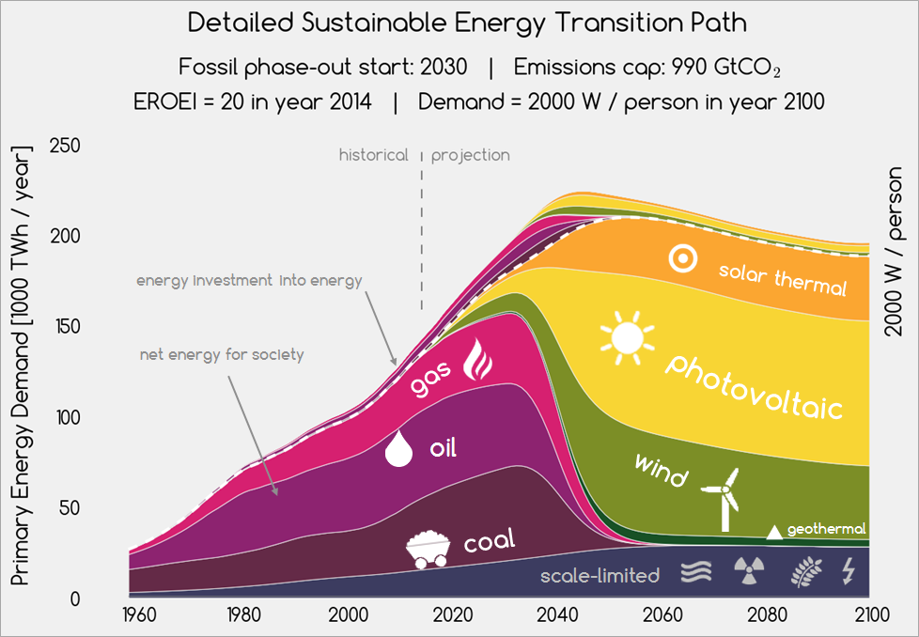
transitions
Own work based on data from, BP, EIA, UNSD, WDI, years 1960-2100, Sgouridis, Csala, Bardi (2016)
Notes:
On top of maximizing GDP as the equivalent of social welfare, IAM’s are also very uncertain

Slide 18
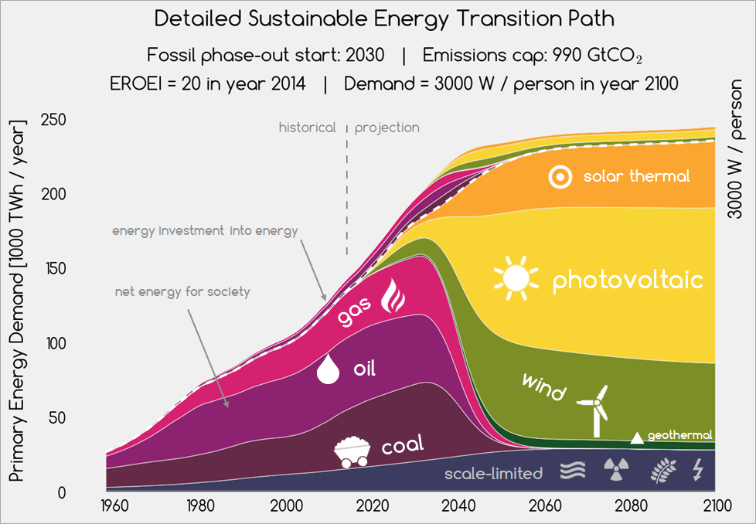
transitions
Own work based on data from, BP, EIA, UNSD, WDI, years 1960-2100, Sgouridis, Csala, Bardi (2016)
Notes:
On top of maximizing GDP as the equivalent of social welfare, IAM’s are also very uncertain

Slide 19
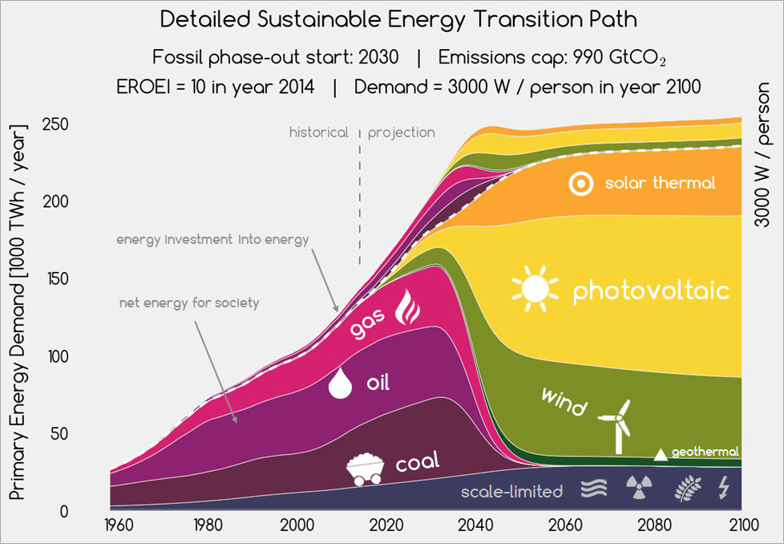
transitions
Own work based on data from, BP, EIA, UNSD, WDI, years 1960-2100, Sgouridis, Csala, Bardi (2016)
Notes:
On top of maximizing GDP as the equivalent of social welfare, IAM’s are also very uncertain

Slide 20
visualizing the
energy transitions of countries under binding climate constraints
global results
Notes:
Wealthy countries could afford to do that because of fossil fuels. 2 problems with that. Depletion and global warming.

Slide 21
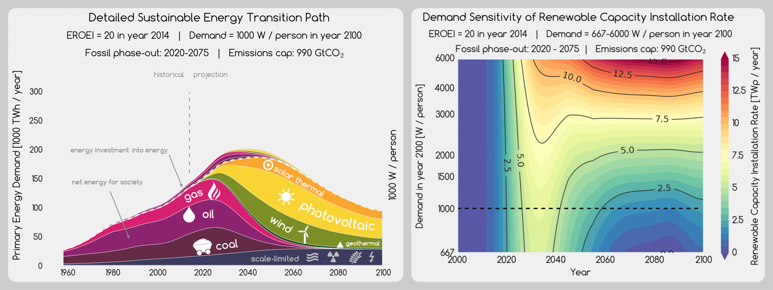
transitions
Own work based on data from, BP, EIA, UNSD, WDI, years 1960-2100, Sgouridis, Csala, Bardi (2016)
Notes:
On top of maximizing GDP as the equivalent of social welfare, IAM’s are also very uncertain

Slide 22
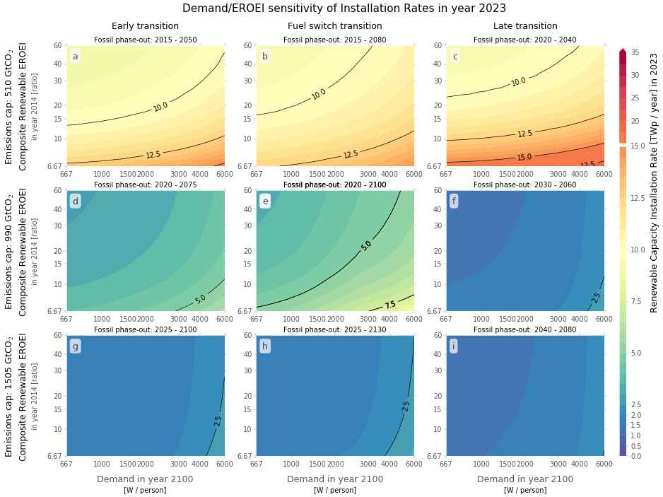
global sensitivity analysis
Transition landscapes
During the transition the deciding factor is EROEI
Later on it is all about Demand
http://set.csaladen.es
Notes:
Wealthy countries could afford to do that because of fossil fuels. 2 problems with that. Depletion and global warming.

Slide 23
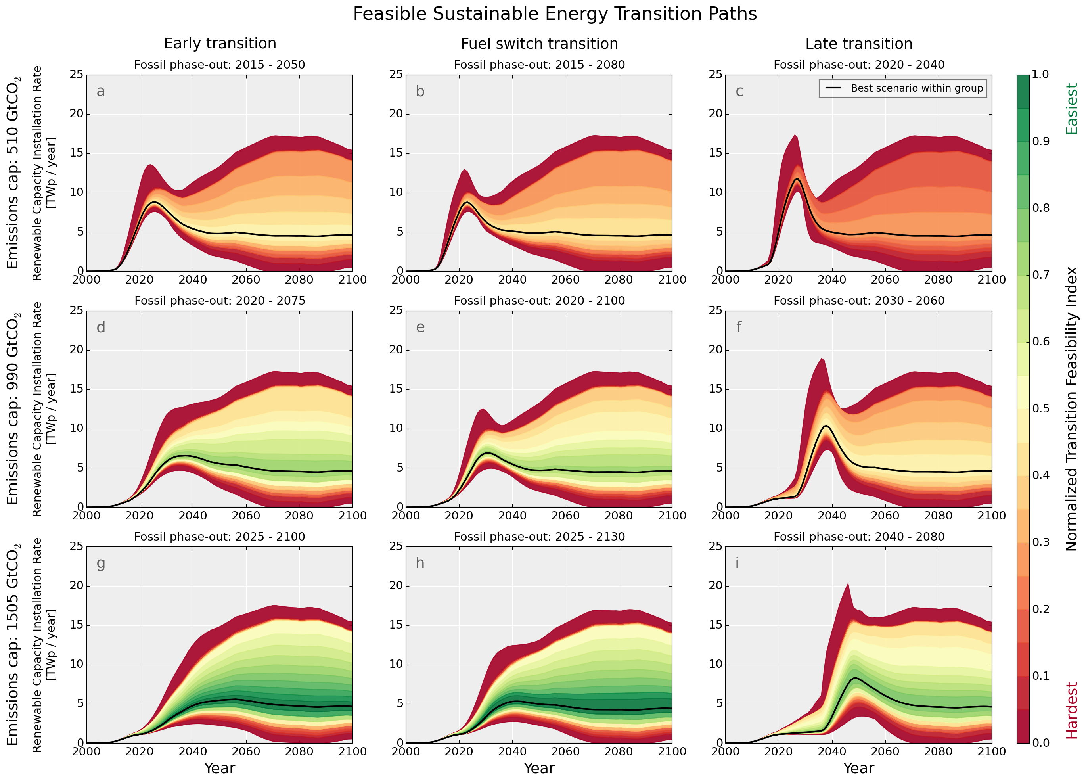
global sensitivity analysis
Feasible transition
Low investment peak
Robust to EROEI and Demand uncertainty
Low continuous investment
Envelopes are narrow during the early transition phase
Hitting the feasible region requires a 55 times increase in renewable energy installation rates within 2-3 decades
Notes:
Wealthy countries could afford to do that because of fossil fuels. 2 problems with that. Depletion and global warming.

Slide 24
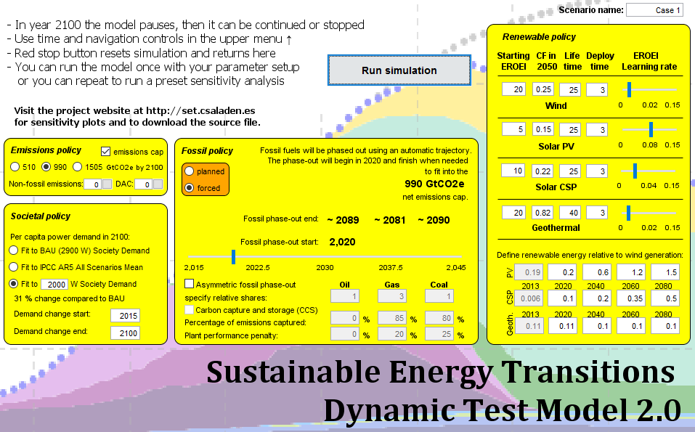
global sensitivity analysis
https://runthemodel.com/models/2104/
Notes:
Wealthy countries could afford to do that because of fossil fuels. 2 problems with that. Depletion and global warming.

Slide 25
visualizing the
energy transitions of countries under binding climate constraints
country results
Notes:
Wealthy countries could afford to do that because of fossil fuels. 2 problems with that. Depletion and global warming.

Slide 26
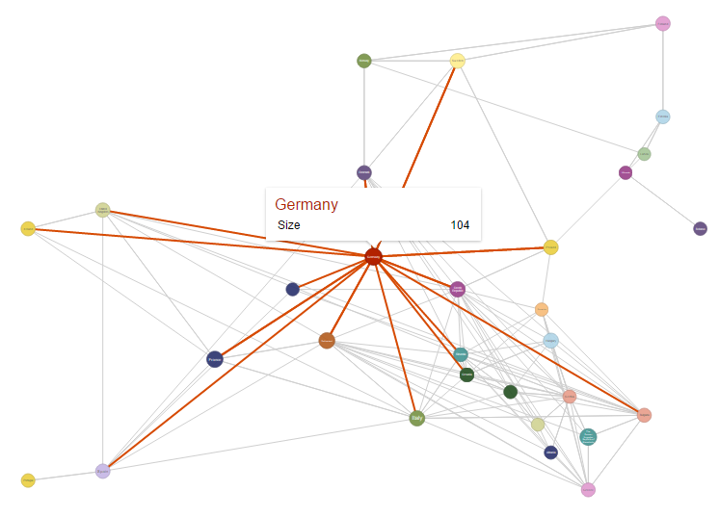
trade network
Collect historical trade data on fossil fuels and electricity from the UN COMTRADE database
Collect historical price data from World Bank Commodities database
Create historical energy trade flow networks
2015 electricity trade network of Europe
Own work based on data from UN COMTRADE, and WDC
Notes:
Wealthy countries could afford to do that because of fossil fuels. 2 problems with that. Depletion and global warming.

Slide 27
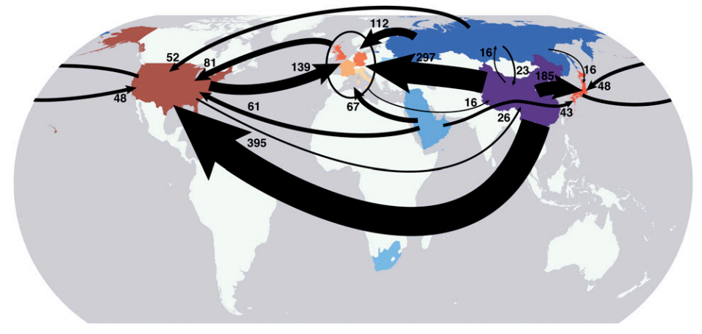
embedded emissions in trade
Davis and Caldeira (2010)
Notes:
Wealthy countries could afford to do that because of fossil fuels. 2 problems with that. Depletion and global warming.

Slide 28
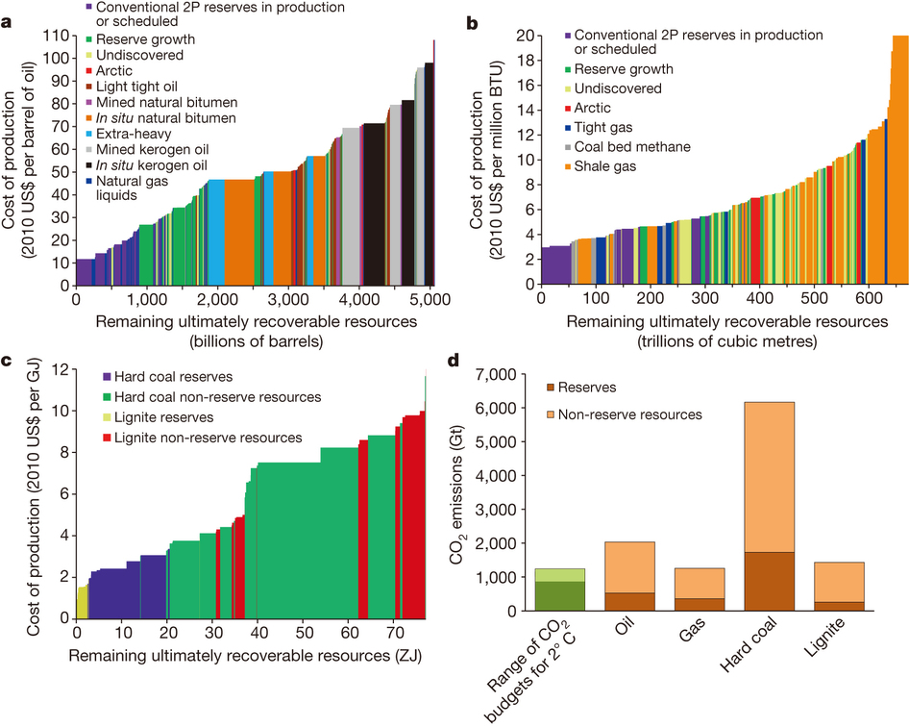
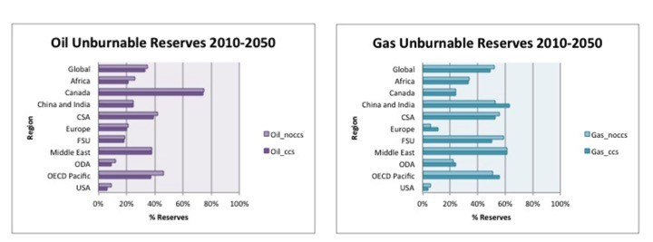
unburnable reserves
McGlade and Ekins (2015)
Notes:
Wealthy countries could afford to do that because of fossil fuels. 2 problems with that. Depletion and global warming.

Slide 29
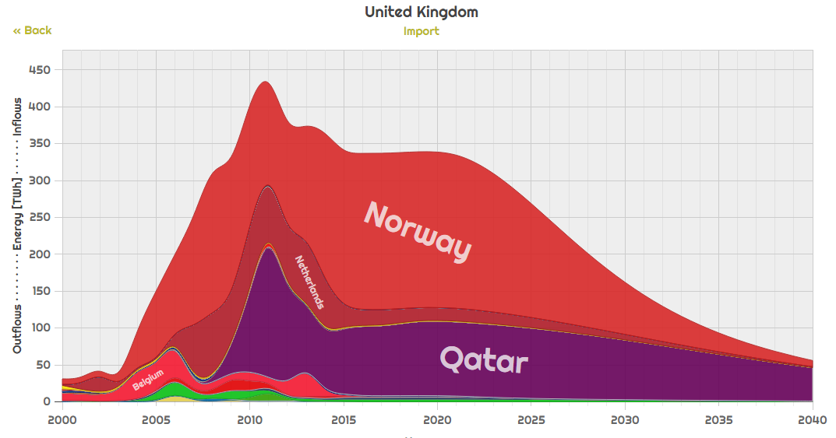

fossil phase-out
http://netset.csaladen.es
NETSET Exploratorium, Csala (2016)
Notes:
Wealthy countries could afford to do that because of fossil fuels. 2 problems with that. Depletion and global warming.

Slide 30
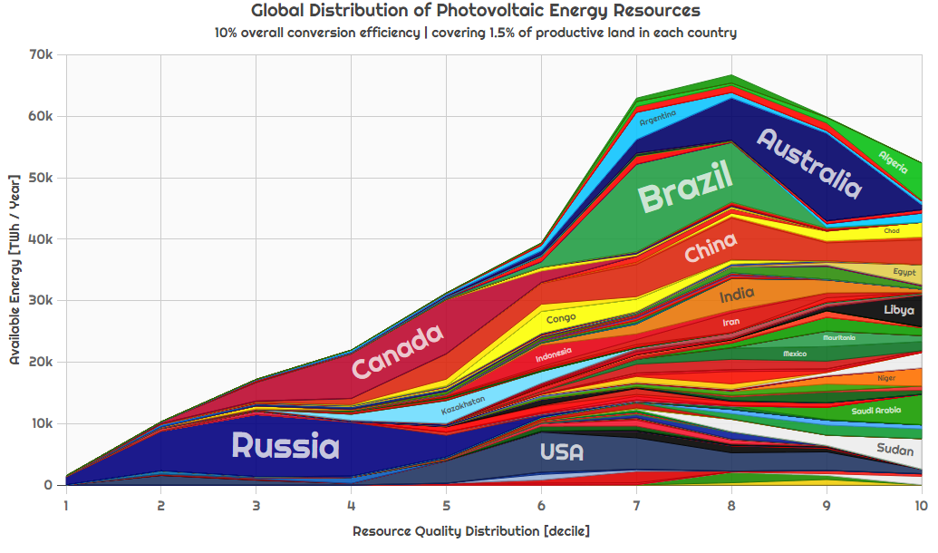
resource distribution
http://netset.csaladen.es
NETSET Exploratorium, Csala (2016)
Notes:
Wealthy countries could afford to do that because of fossil fuels. 2 problems with that. Depletion and global warming.

Slide 31
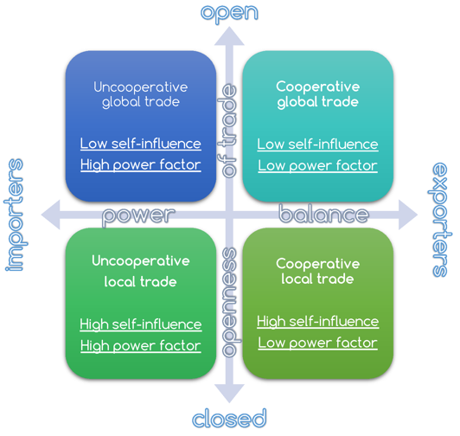
http://www.csaladen.es/doc/Denes_NETSET_process_diagram.pdf
NETSET Exploratorium, Csala (2016)
Notes:
Wealthy countries could afford to do that because of fossil fuels. 2 problems with that. Depletion and global warming.

Slide 32
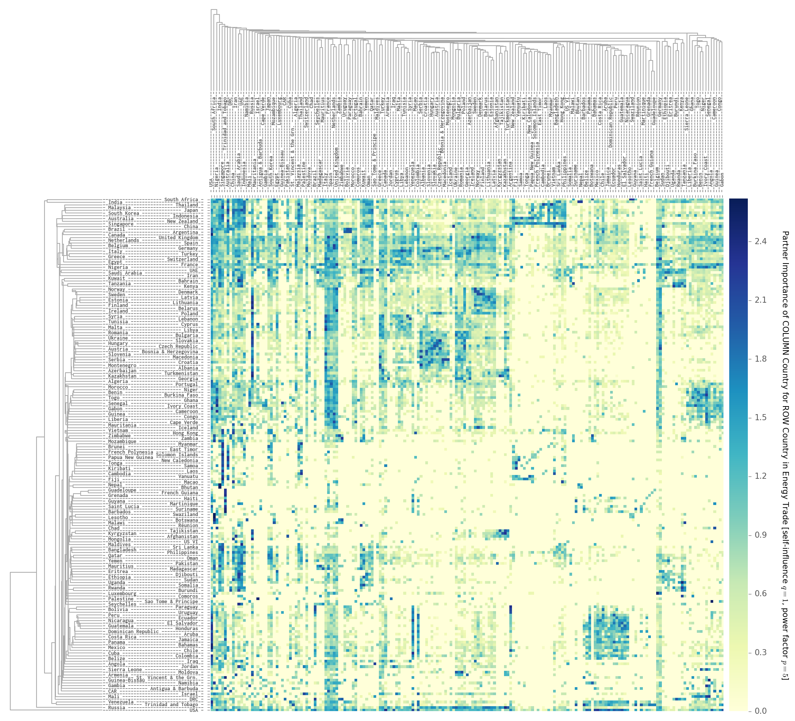
trade cost
NETSET Exploratorium, Csala (2016)
Notes:
Wealthy countries could afford to do that because of fossil fuels. 2 problems with that. Depletion and global warming.

Slide 33
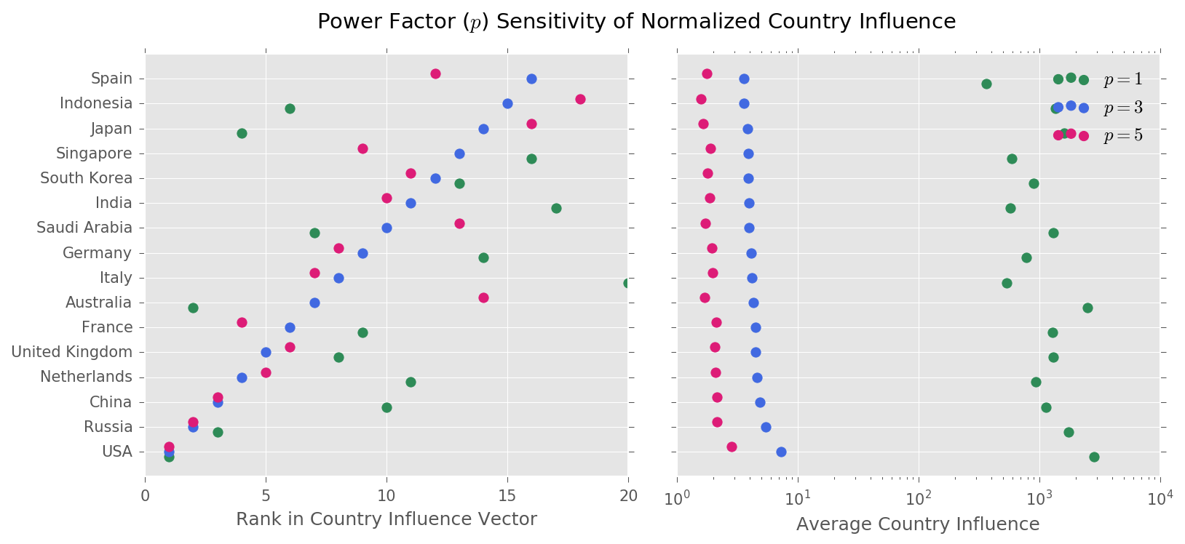
country influence vector
NETSET Exploratorium, Csala (2016)
Notes:
Wealthy countries could afford to do that because of fossil fuels. 2 problems with that. Depletion and global warming.

Slide 34
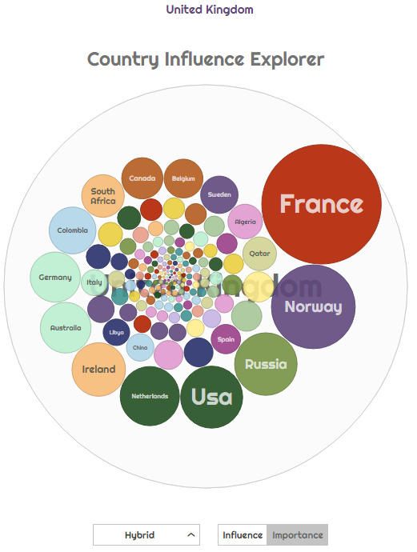
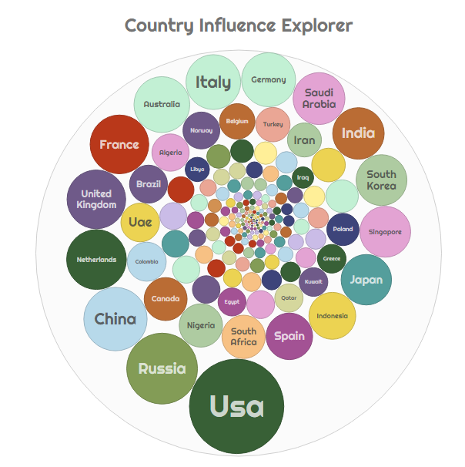
country influence explorer
http://netset.csaladen.es /bubbles.html
NETSET Exploratorium, Csala (2016)
Notes:
Wealthy countries could afford to do that because of fossil fuels. 2 problems with that. Depletion and global warming.

Slide 35
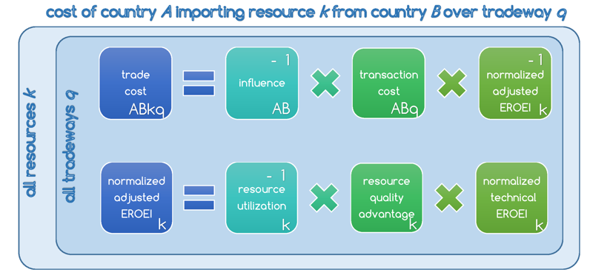
trade cost allocation algorithm
NETSET Exploratorium, Csala (2016)
Notes:
Wealthy countries could afford to do that because of fossil fuels. 2 problems with that. Depletion and global warming.

Slide 36
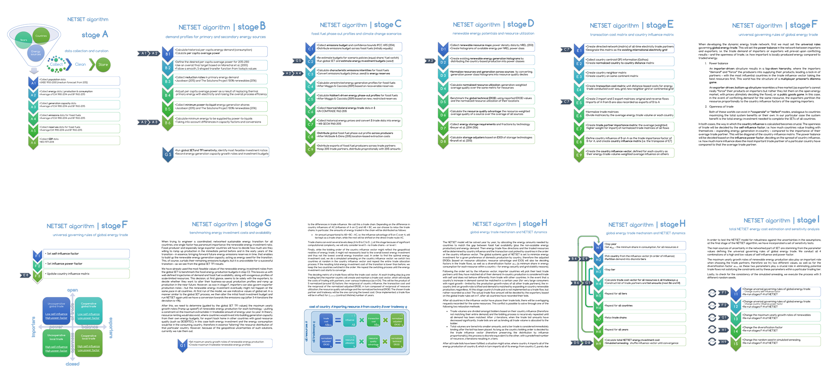
trade cost allocation algorithm
NETSET Exploratorium, Csala (2016)
http://www.csaladen.es/doc/Denes_NETSET_process_diagram.pdf
Notes:
Wealthy countries could afford to do that because of fossil fuels. 2 problems with that. Depletion and global warming.

Slide 37
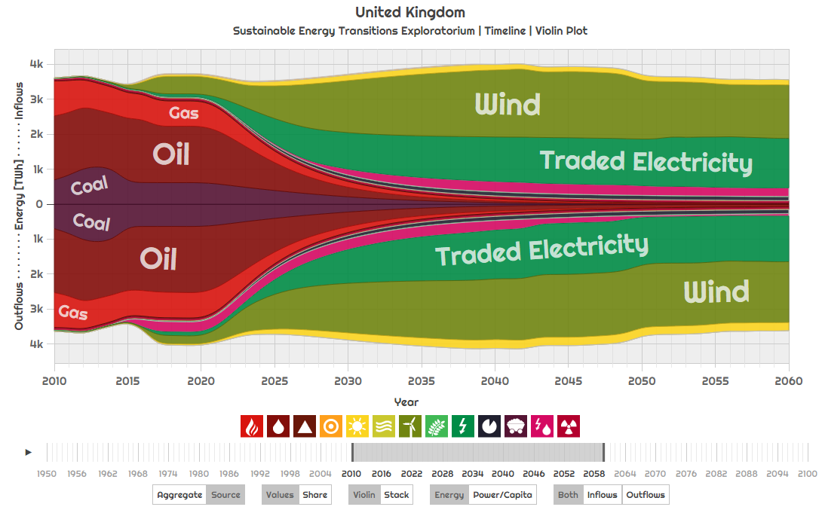
country results
http://netset.csaladen.es
NETSET Exploratorium, Csala (2016)
Notes:
Wealthy countries could afford to do that because of fossil fuels. 2 problems with that. Depletion and global warming.

Slide 38
visualizing the
energy transitions of countries under binding climate constraints
wrap-up
Notes:
Wealthy countries could afford to do that because of fossil fuels. 2 problems with that. Depletion and global warming.

Slide 39

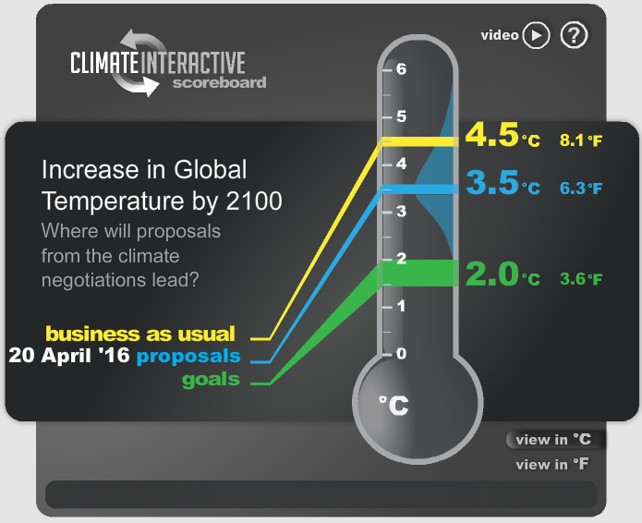
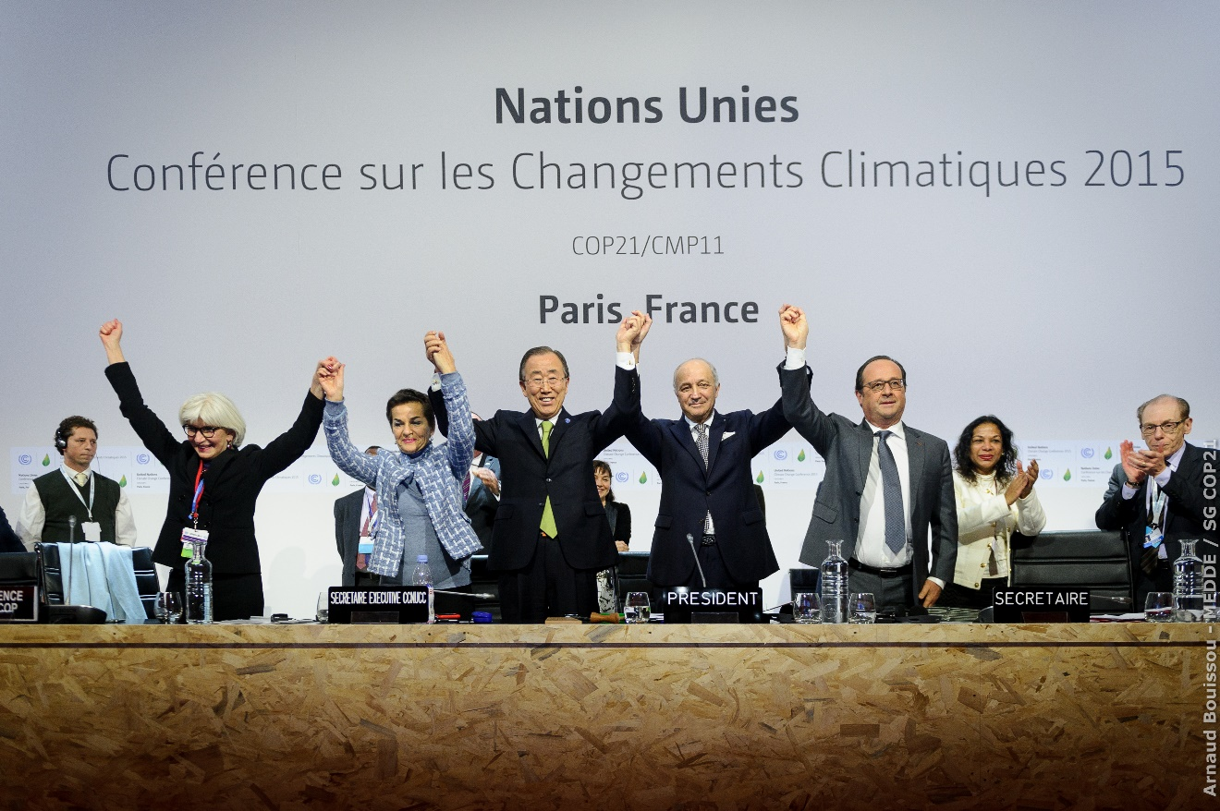
Climate Interactive (2016), image source: Huffington Post
Notes:
Garrett Hardin

Slide 40
visualizing the
energy transitions of countries under binding climate constraints
Lancaster University
7th April 2017

